Slide 1

What is a Comprehensive Plan?

Slide 2
A Comprehensive Plan is a guide for how the County will grow and develop to meet future needs and reflect the community’s vision.
Caroline County Map
The towns within Caroline County are all incorporated municipalities that develop and adopt their own Comprehensive Plans and Zoning Codes.
The County Comprehensive Plan applies to all unincorporated areas outside of town limits.

Slide 3
What is in the Comprehensive Plan? Although Maryland has since updated the requirements for a comprehensive plan, the 2026 Caroline County Comprehensive Plan still incorporates the 12 Planning Visions, which are:
Quality of Life and Sustainability
Public Participation
Growth Areas
Community Design
Infrastructure
Transportation
Housing
Economic Development
Environmental Protection
Resource Conservation
Stewardship
Implementation

Slide 4
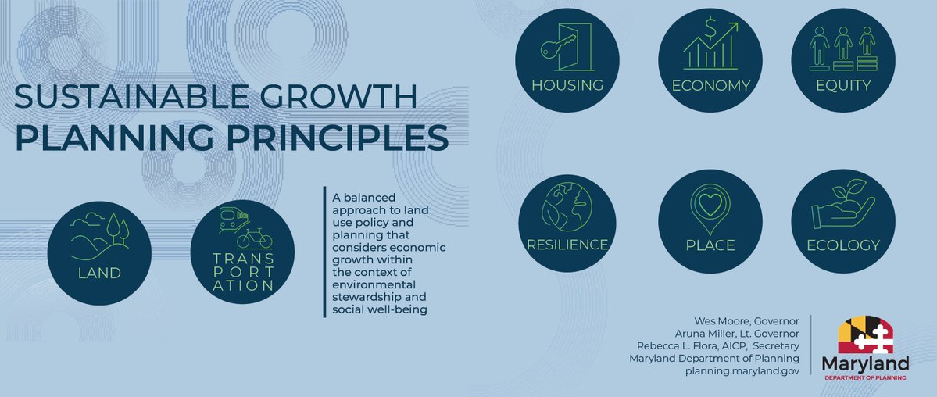
New Requirements for Comprehensive Plans
In 2025, legislation was passed creating the Sustainable Growth Planning Principles. These 8 principles replace the former 12 Planning Visions and guide Maryland’s shift from Smart Growth to Sustainable Growth.
Since this comprehensive plan was already well underway when the new requirement was introduced, it will not be formally incorporated until the next plan update (2036). However, the current plan does meet these requirements, and a summary will be included to demonstrate this.

Slide 5

What is NOT in the plan:
Specific regulations and ordinances such as zoning codes, subdivision regulations, or approval processes which are adopted to implement the direction of the plan.
A public improvement funding (or capital) plan, but it can provide direction for future studies and projects.

Slide 6

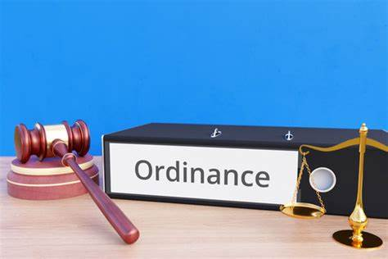
What is the difference between the Comprehensive Plan and the Zoning Code?
The Comprehensive Plan is a guide for how land should be used to meet the needs of the community. Once it is adopted, the Zoning Code—which sets rules for land use and development—will also be updated to support the Comprehensive Plan goals. It's important to get involved in updating the Comprehensive Plan because it shapes future zoning rules.

Slide 7
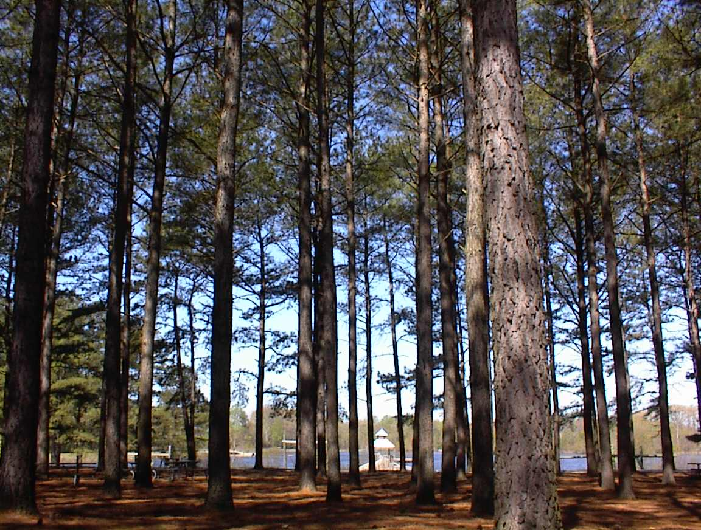

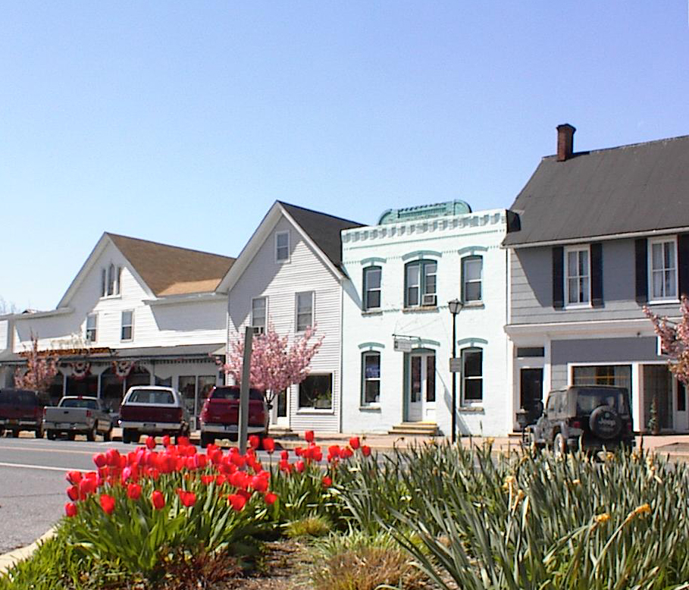
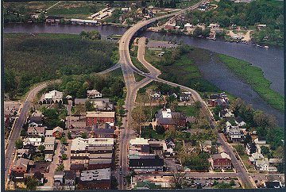

How often is the Comprehensive Plan updated?
Caroline County
Comprehensive Plan
2026
The next Caroline County Comprehensive Plan
2036

Slide 8
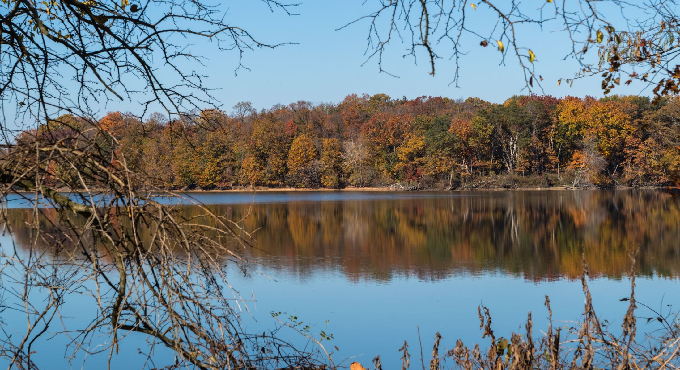
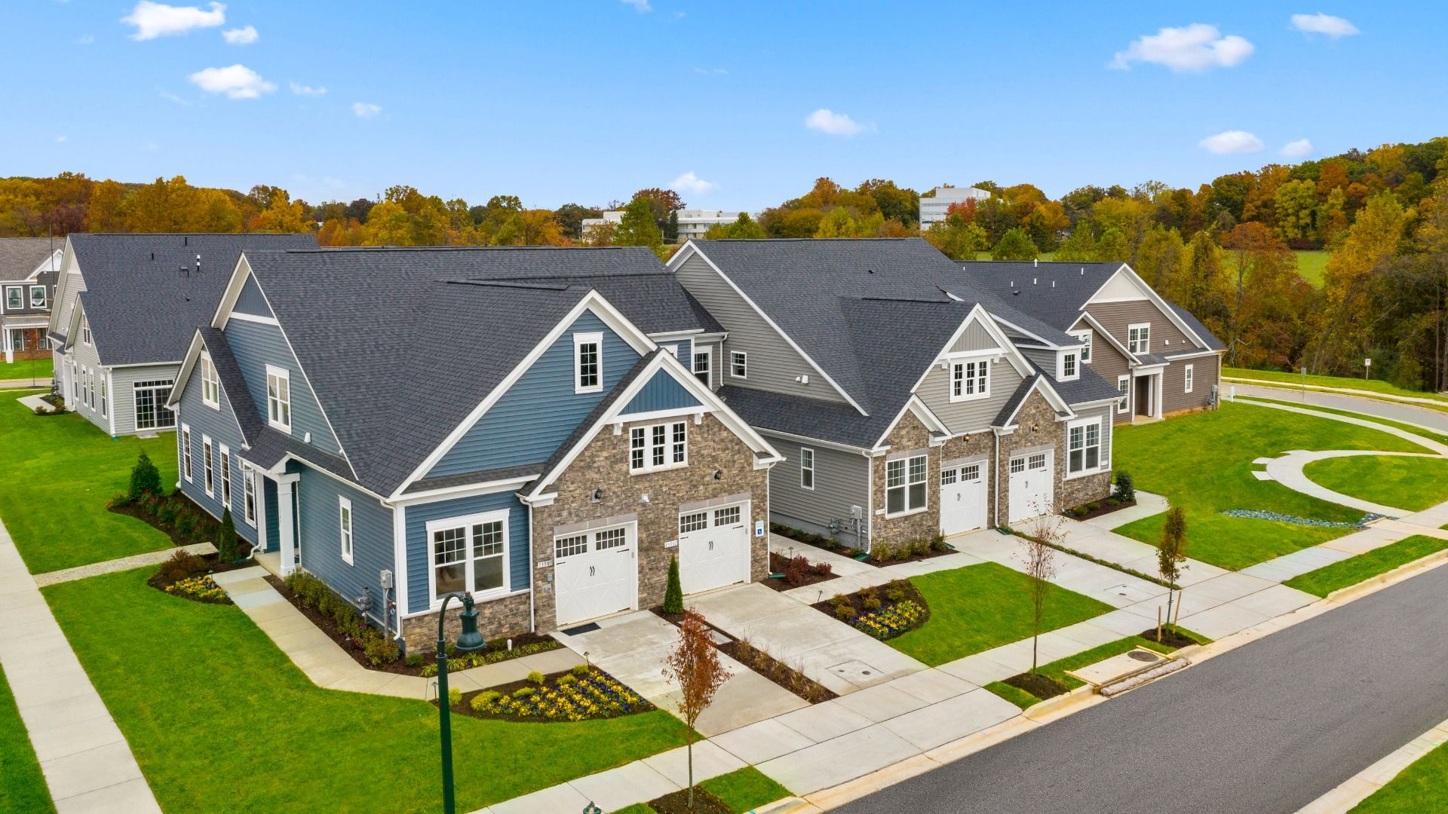
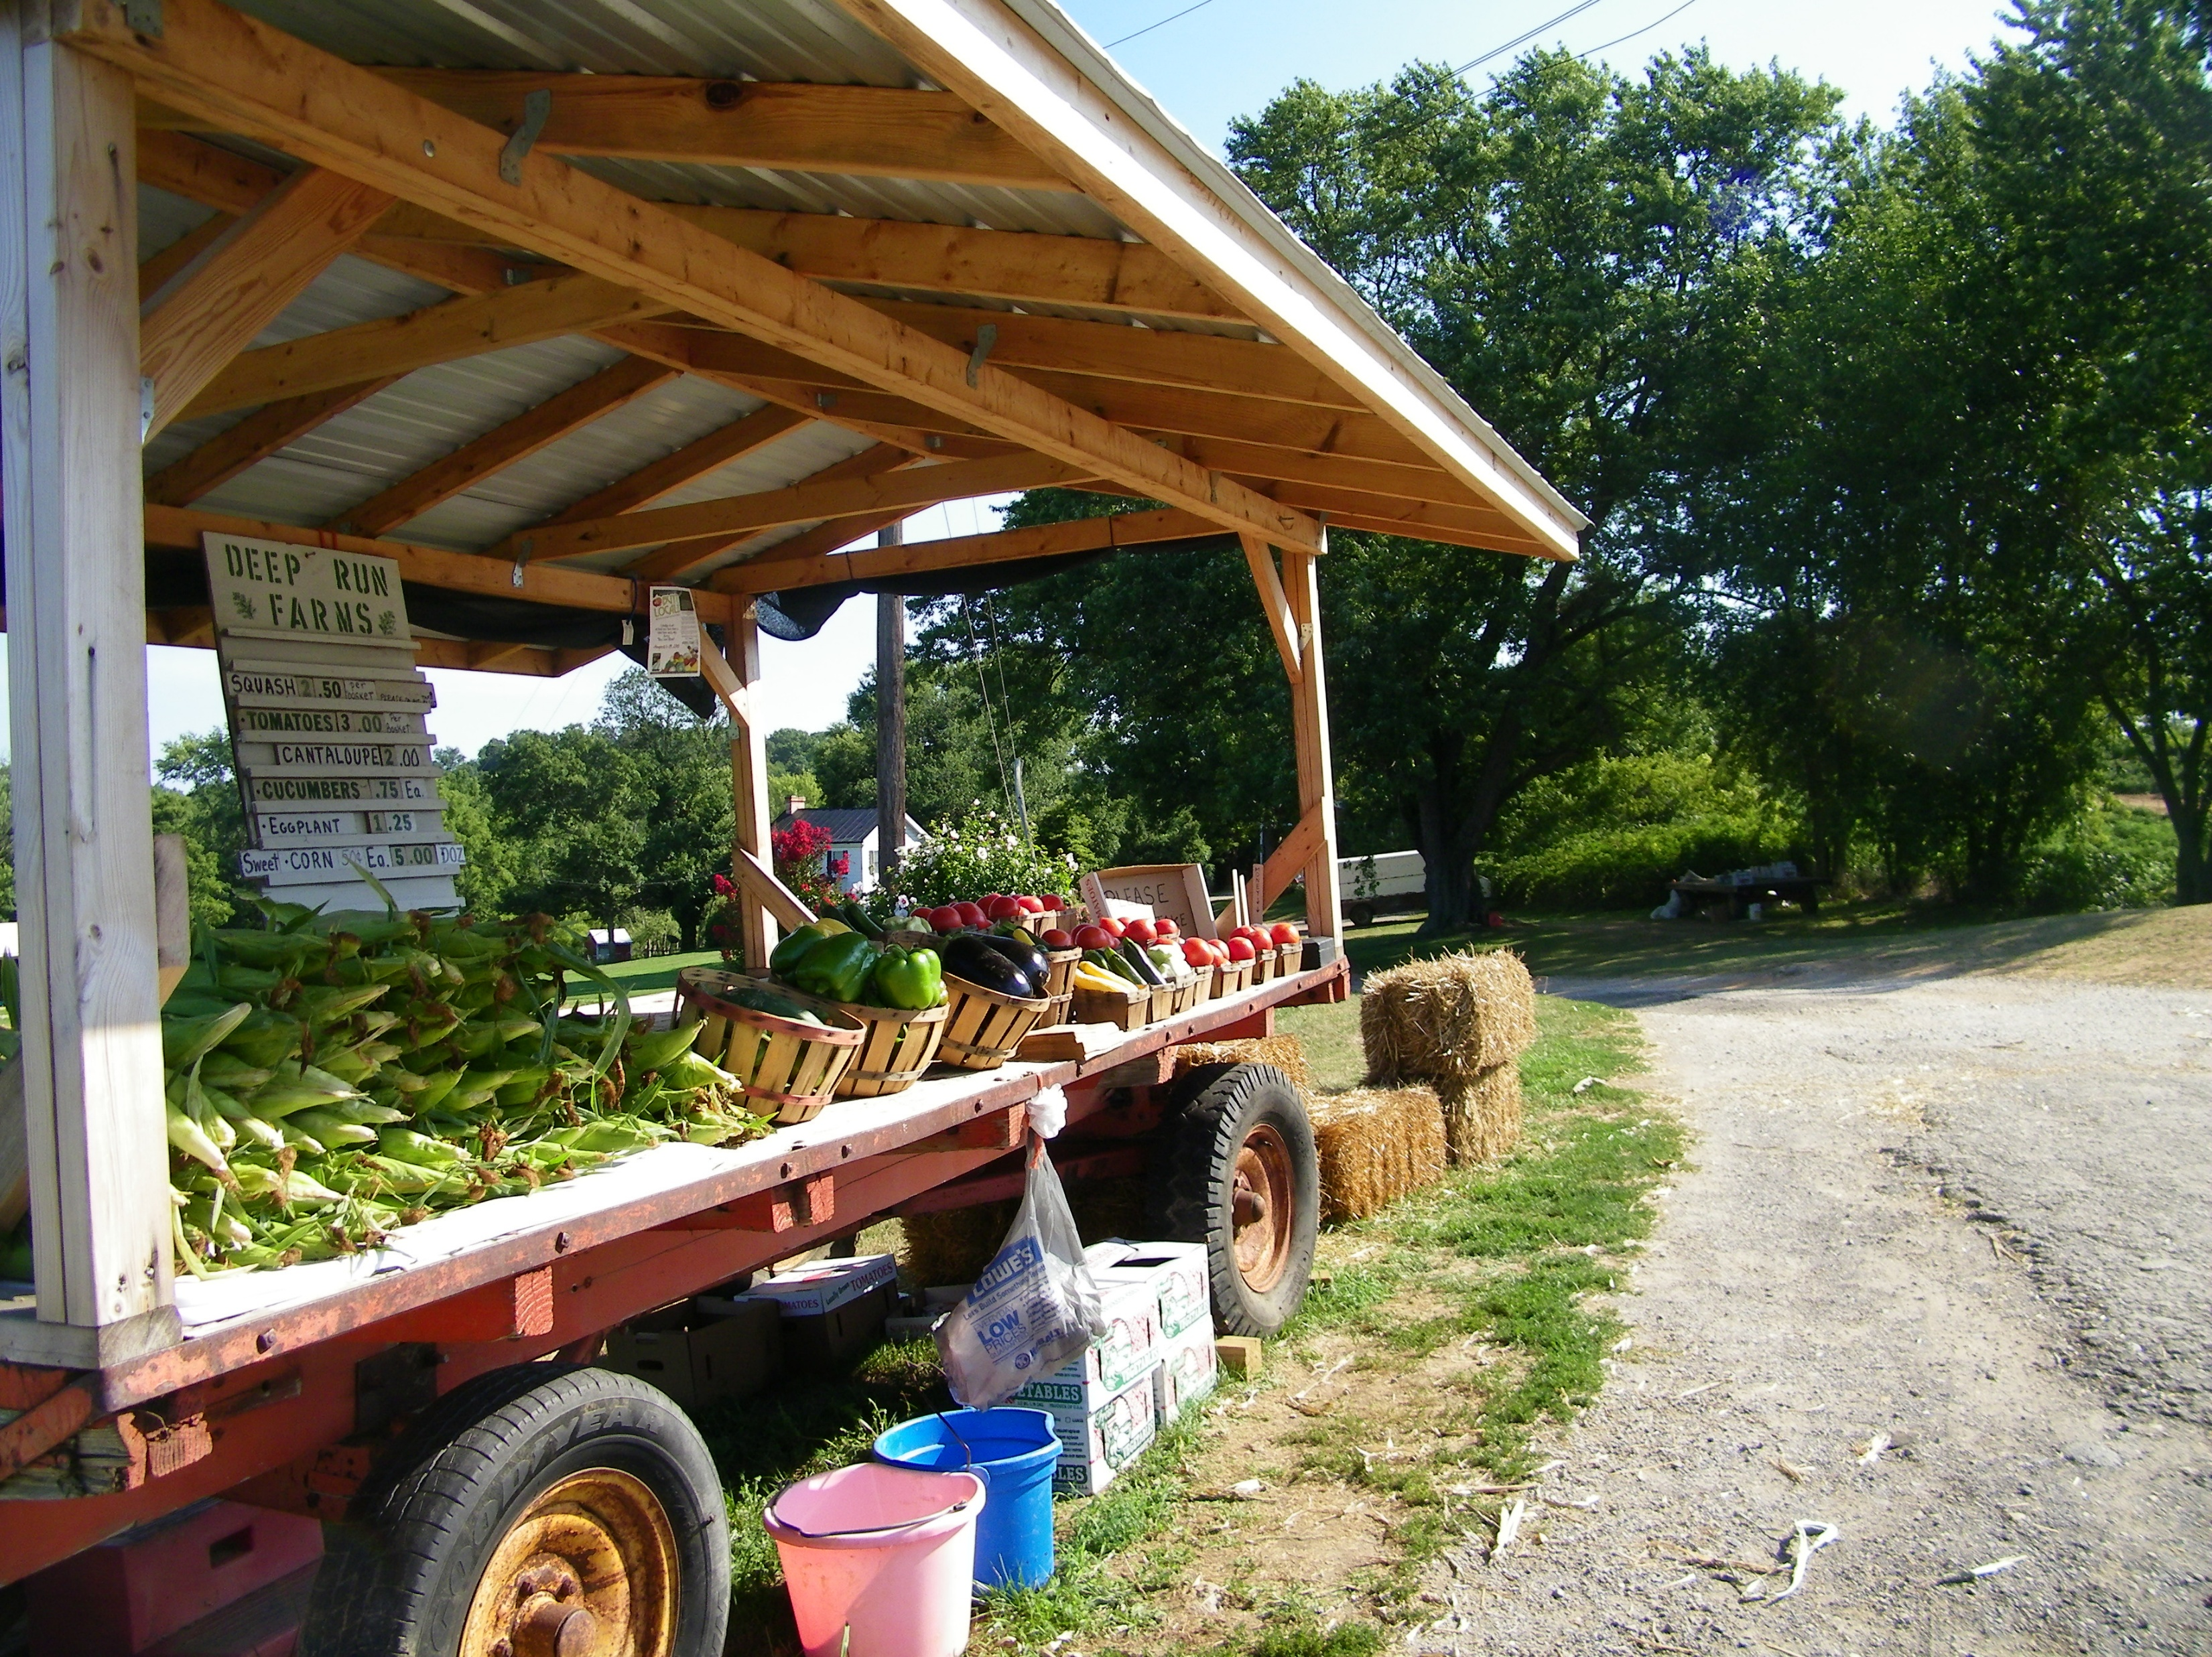
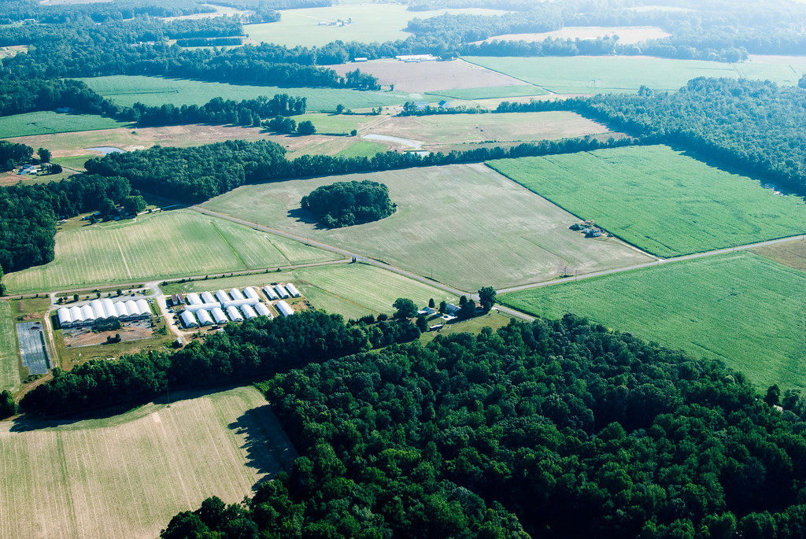
Why is the Comprehensive Plan Important?
This plan basically answers the questions where should growth occur, what should be preserved, and how should the County invest in public resources.

Slide 9


POPULATION and GROWTH
Per the US Census 2020 data, the population for Caroline County was 33,293 with the largest age groups being 60-64 and 5-9 years old.
The population projection for 2035 is 35,240

Slide 10



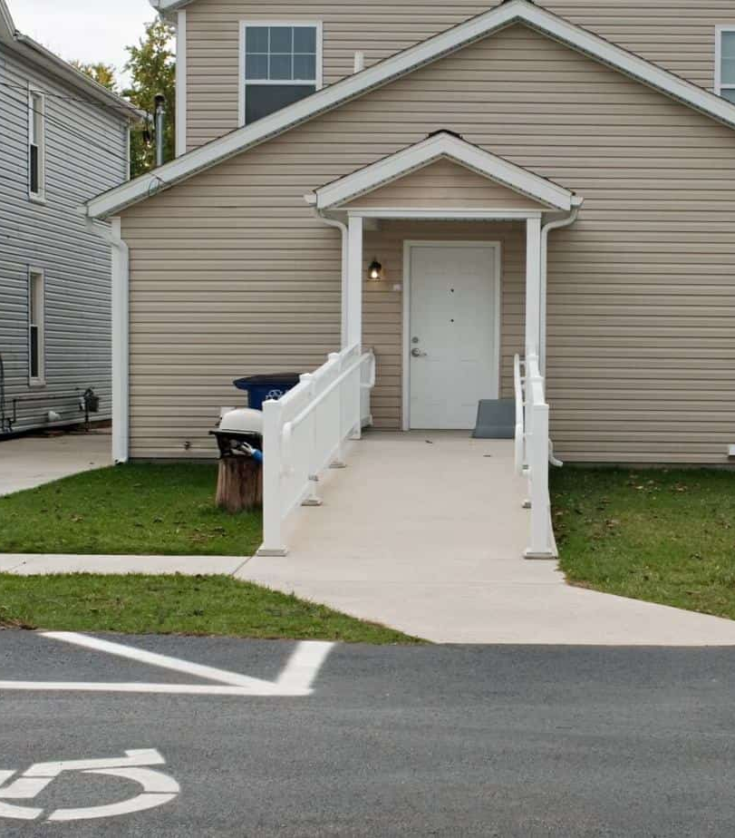
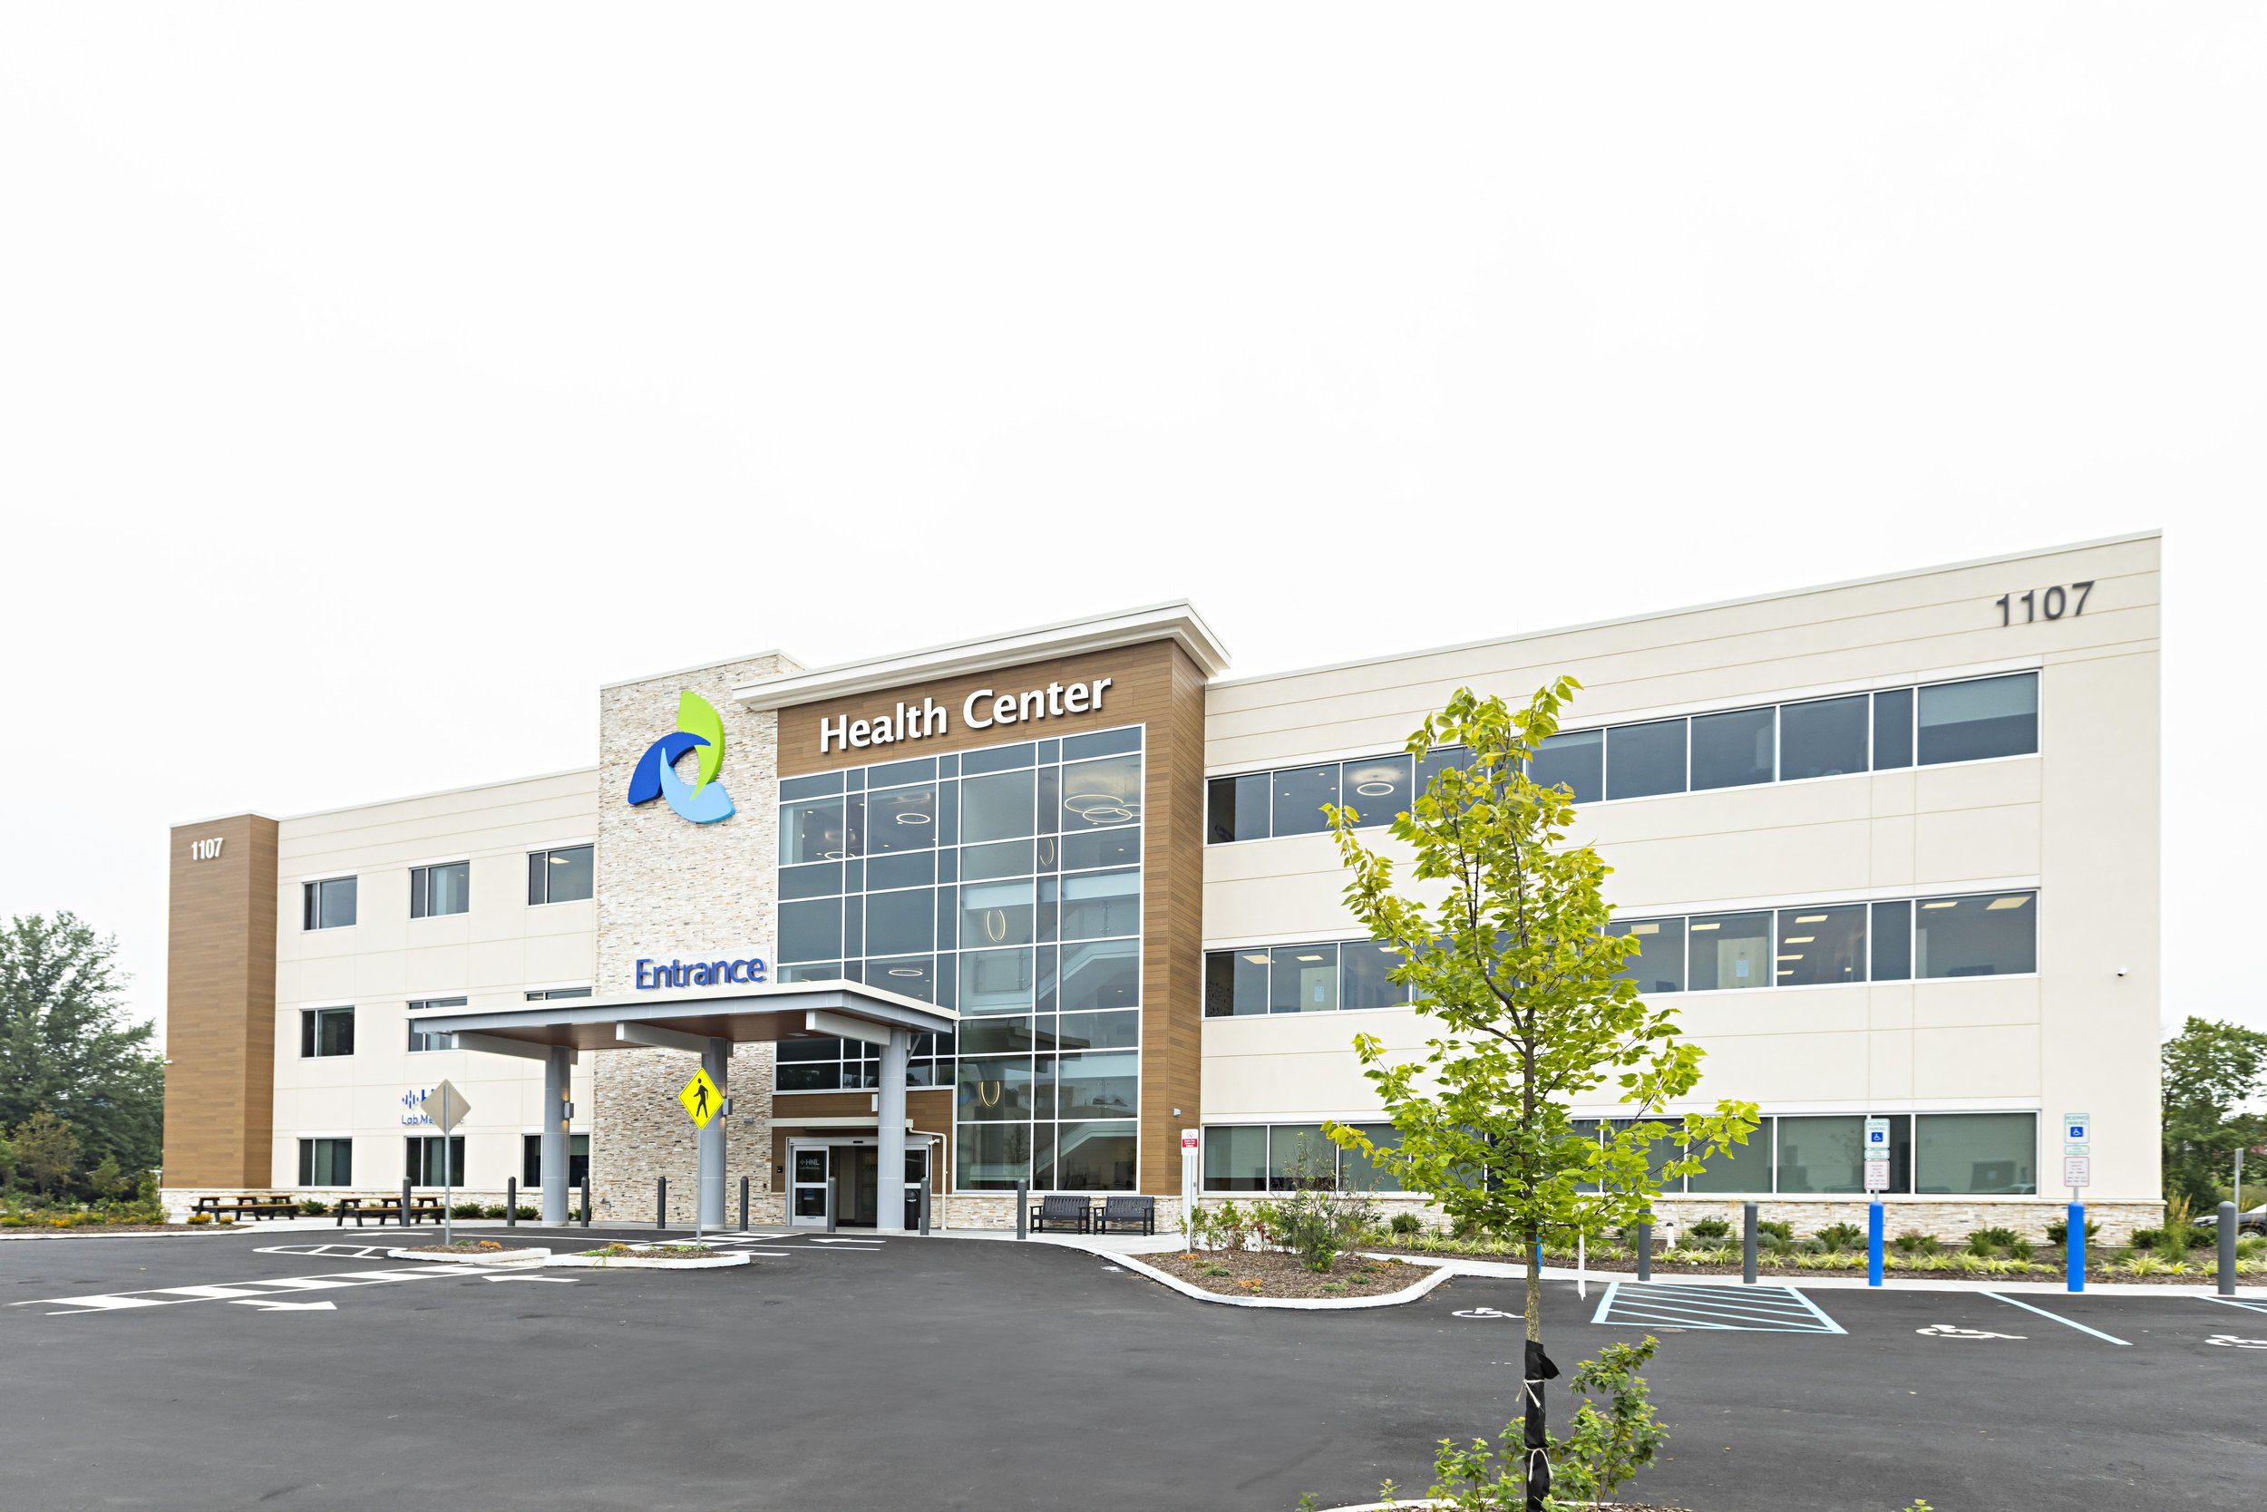
Planning Ahead
These age groups will influence the types of services and amenities needed over the next decade with impacts to schools, transportation, medical facilities, workforce demands and housing needs.

Slide 11
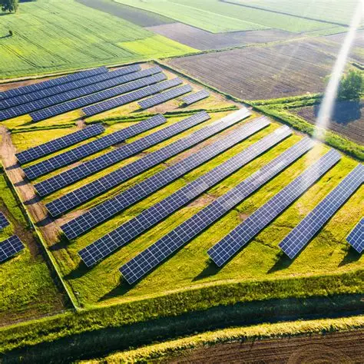
Impact of new legislation:
The Renewable Energy Certainty Act (HB 1036/SB931) was adopted on April 7, 2025. This bill prohibits local governments from making zoning changes that prevent solar and energy storage projects from being developed. The new law includes a cap to limit solar development in designated County Priority Preservation Areas to a maximum of 5% of the total Area. Caroline County’s designated Priority Preservation Area is approximately 126,468 acres and comprises most of the R-Rural zoning district.
This will impact the predominant landscape of farm fields that has been the vista in Caroline County for many decades. Solar farms can take up large areas of agricultural land, reducing food production, poultry farms and open fields for livestock grazing. This land-use conflict will impact local farming economies and food security.

Slide 12
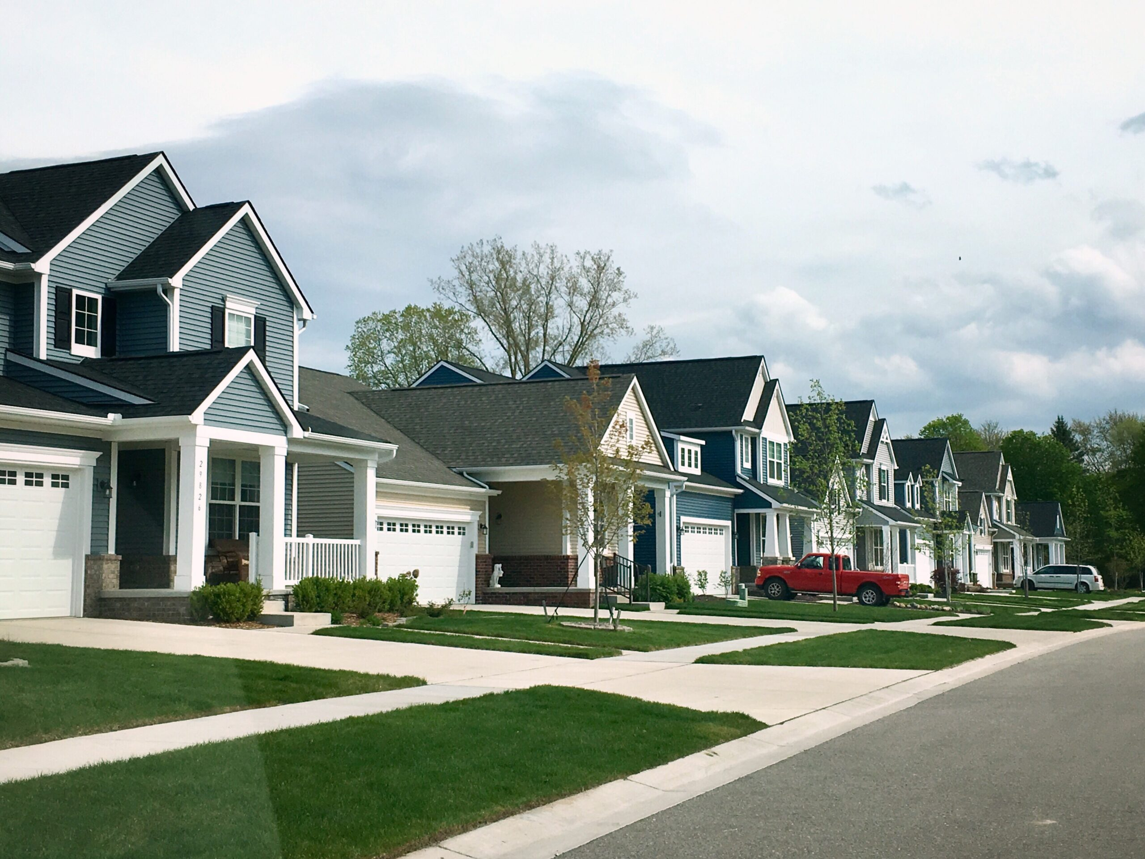
House Bill 538 – Housing Expansion and Affordability Act
Allow certain manufactured or modular homes in residential zones that allow single-family homes, with specific criteria.
Promote additional density.
Effective January 1, 2025

Slide 13
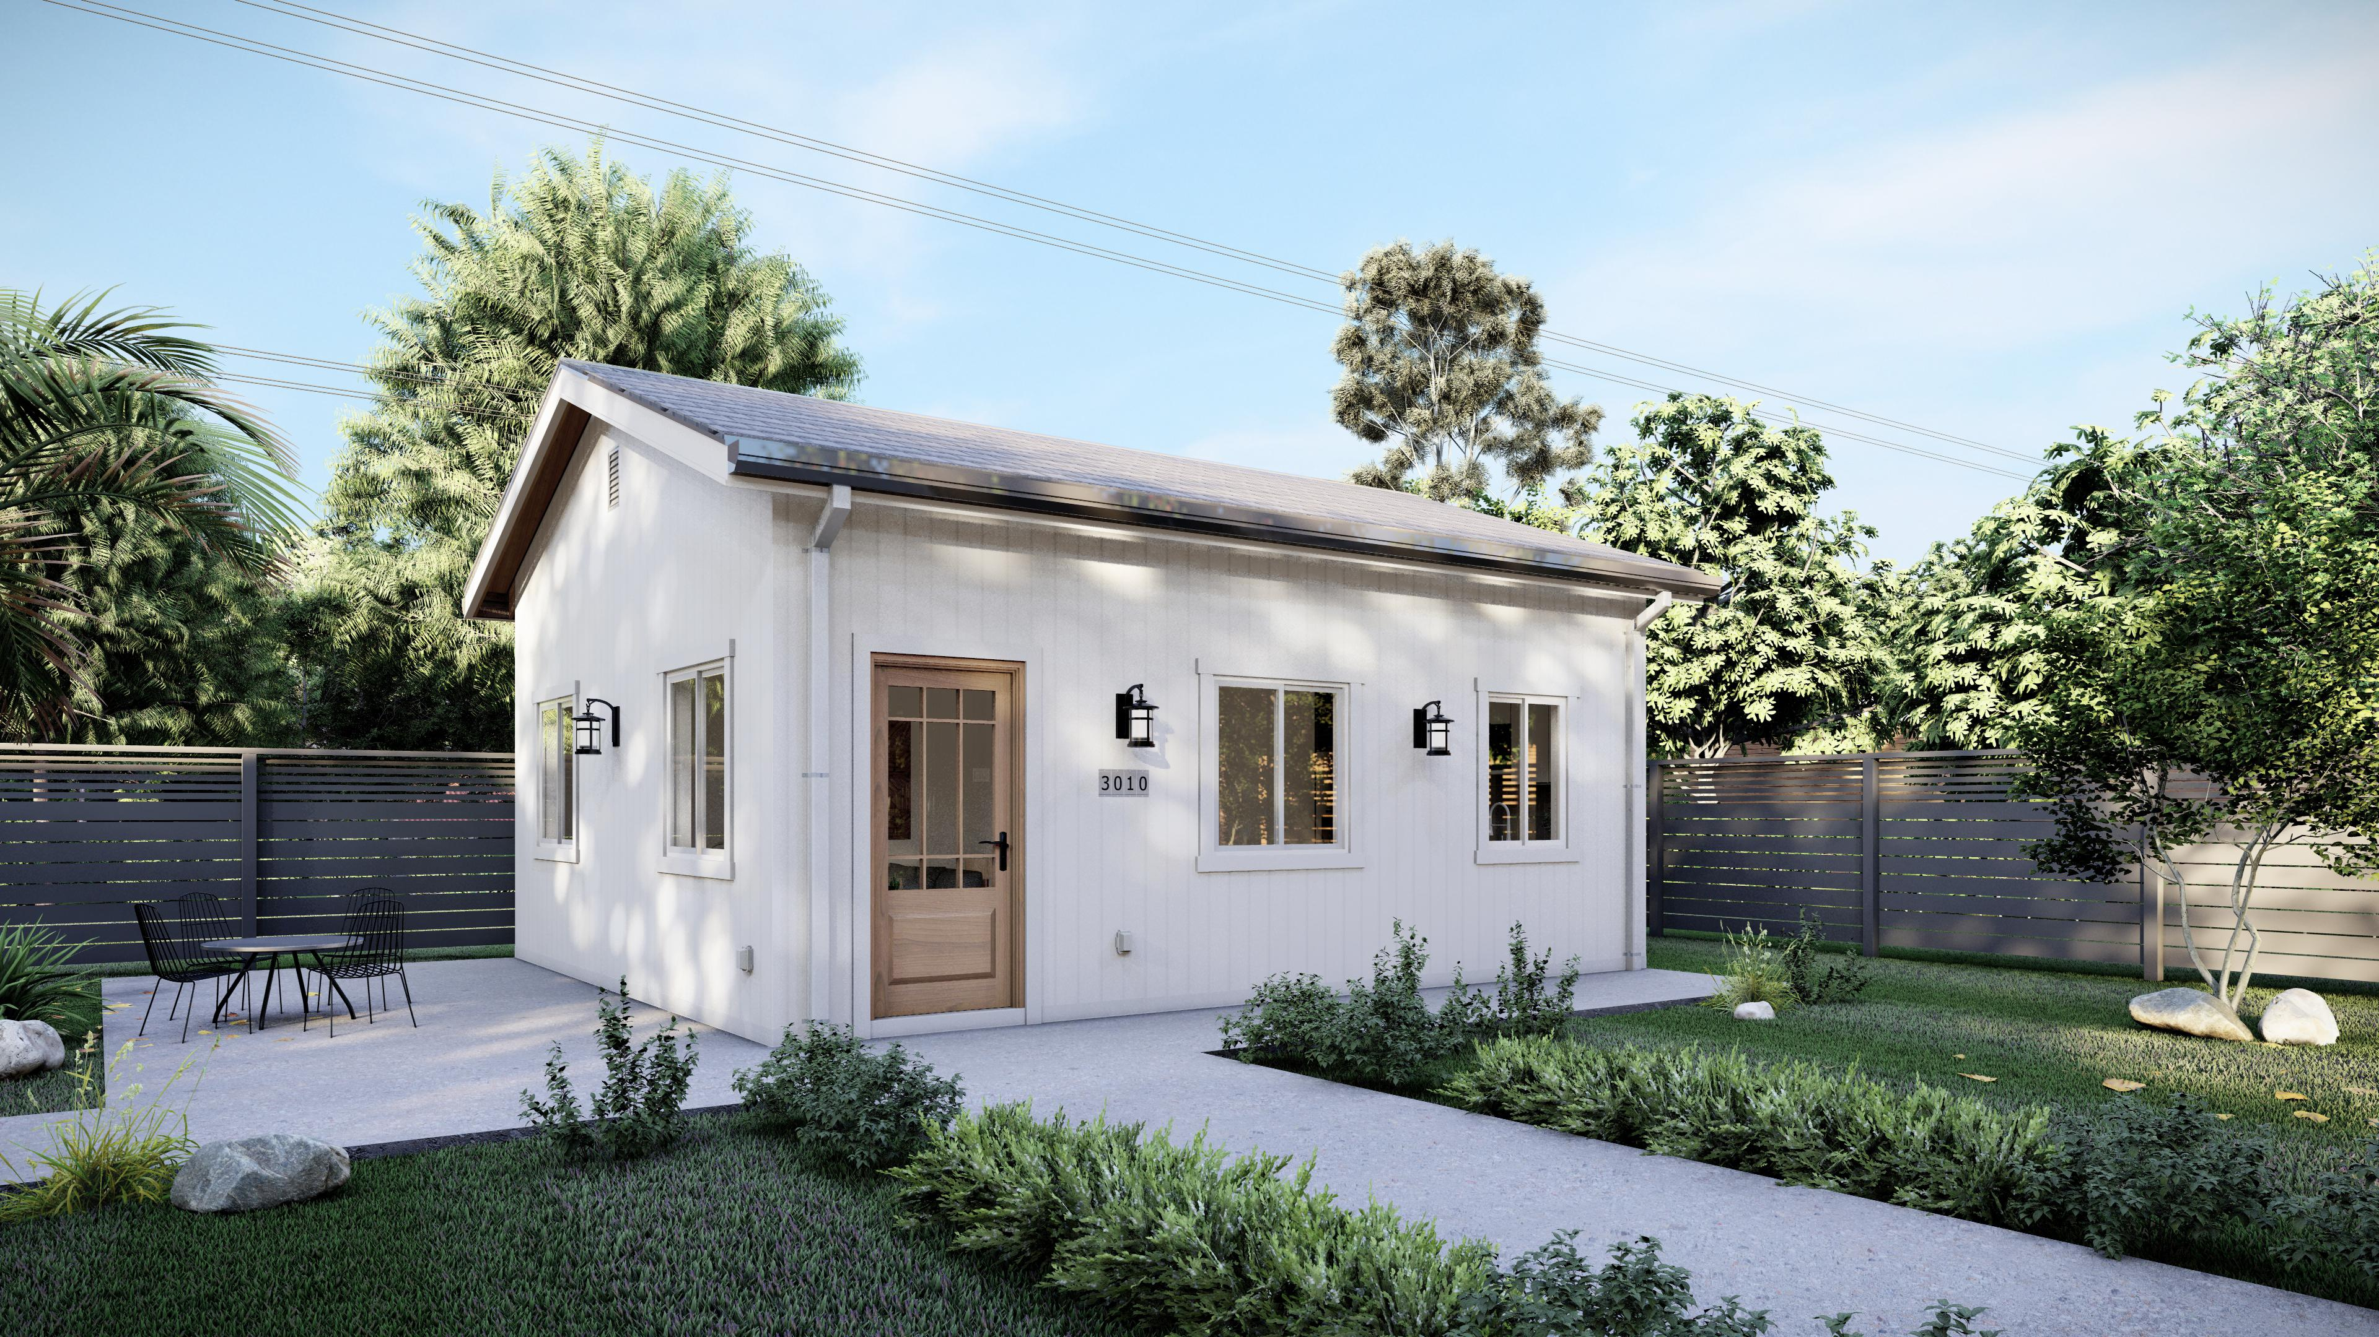
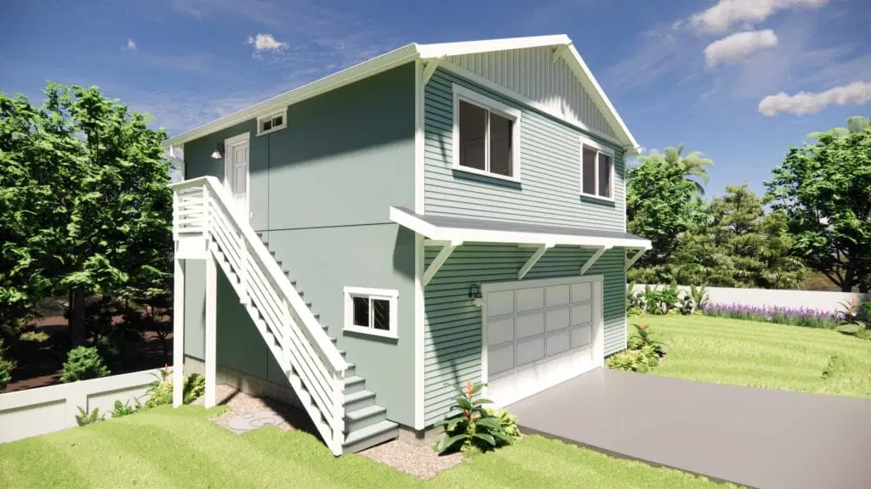
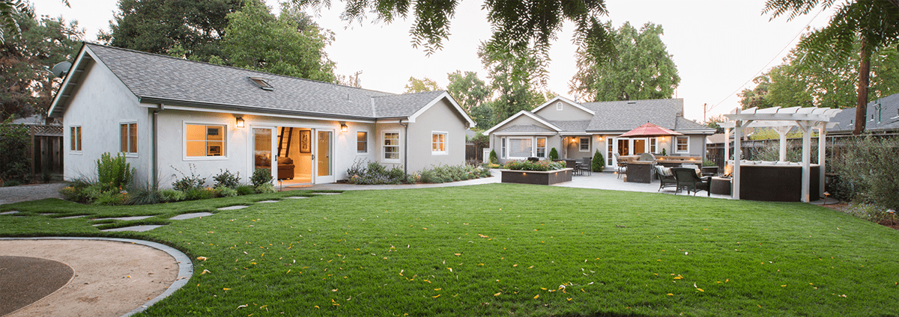
House Bill 1466 – Accessory Dwelling Units Act of 2025
To promote and encourage the creation of Accessory Dwelling Units (ADUs) on properties zoned for single-family homes.
Increase housing availability and affordability by allowing a secondary dwelling unit on property.
ADUs can be detached, attached to the primary house, or conversion of an existing basement or accessory structure.
Implementation of a Statewide policy framework to promote the development of ADUs, prohibits unreasonable restrictions or regulations, and requires updating of all homeowners’ association (HOA) rules to allow ADUs.
Effective October 1, 2025. Local governments must adopt or revise their own ADU laws for consistency by October 1, 2026.

Slide 14
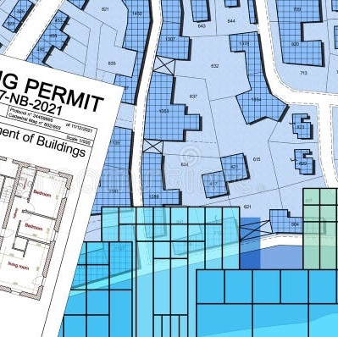
“Housing Starts Here” Executive Order September 3, 2025
Builds on the Housing Expansion and Affordability Act.
Key objectives are to streamline state permitting timelines, leverage state-owned property for transit-oriented development, set local housing goals and State to appoint an ombudsman to assist with permits and projects.
Requires Maryland Department of Housing and Community Development (DHCD) to work with local jurisdictions to set housing production targets – to be published January 2026, updated every 5 years.
Part of the strategy to make housing more affordable and to address the housing shortage.

Slide 15
Comprehensive Plan Required Elements (chapters)
Resource Conservation
Mineral Resources
Land Use
Priority Preservation Area
Water Resources
EACH ELEMENT INCLUDES:
Community Facilities
Transportation
Economic Development
Housing
Relevant statistical data (population, demographics, acreages, inventories of resources, etc.)
Summary of regulatory protections and issues
Long-term goals and priorities for improvement, protection and preservation along with implementation outlining the actions, policies, and resources necessary to achieve the goals.
All elements must address State requirements for comprehensive plans

Slide 16
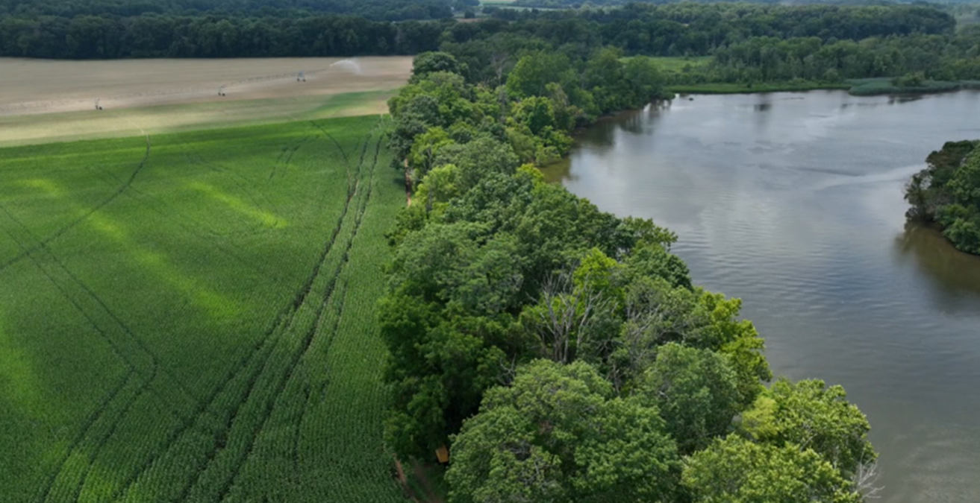
Resource Conservation
Areas that are characterized by natural environments such as forests and wetlands, or resource-utilization activities like agriculture and forestry.
These areas are intended to be protected and managed to maintain their ecological value, support natural resource-based industries, and preserve habitat for wildlife.

Slide 17

Mineral Resources
Mineral resources are recognized as a priority resource essential to the regions’ economic development.
This section identifies lands with the potential for mineral extraction – predominantly sand and gravel - and acknowledges existing mining locations.
This plan considers how to balance the extraction and use of mineral resources with other land uses while addressing potential environmental and social impacts.

Slide 18

Transportation
This element covers how many transportation systems like roads, public transit, sidewalks, and bike lanes, are planned and developed.
It focuses on identifying existing transportation infrastructure along with the communities needs – both for people and goods – now and into the future.

Slide 19
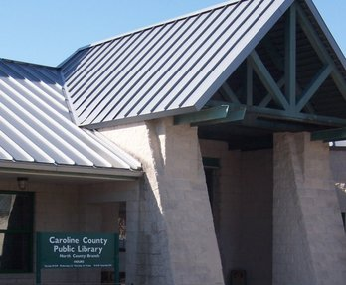

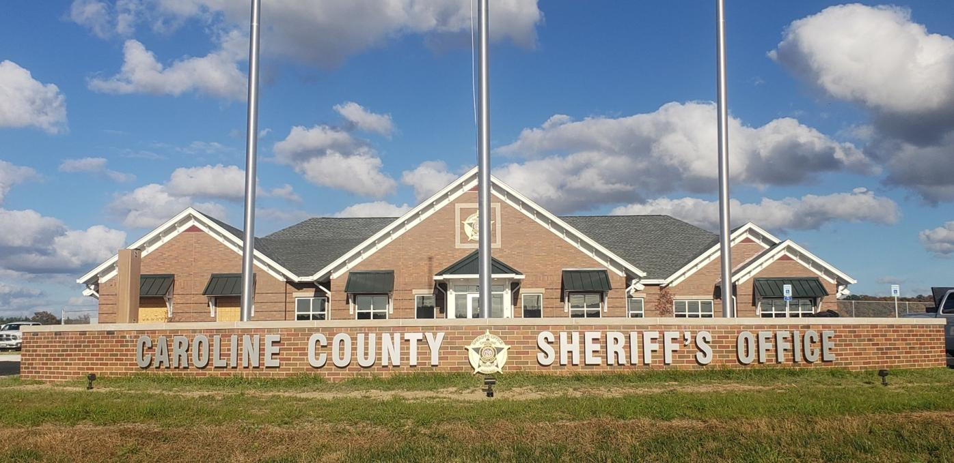
Community Facilities
Community facilities refers to public and semi-public buildings, lands and facilities that are essential for community life.
This element of the plan identifies their locations and character, ensuring they are adequate to meet community needs and are consistent with other elements of the plan, like land use.

Slide 20
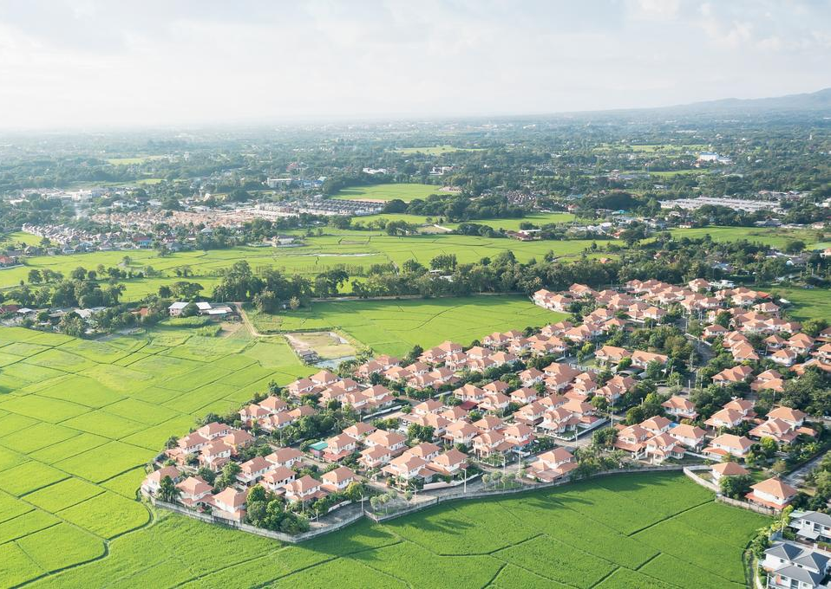
Land Use
Land use refers to the intended use of land for various purposes, such as residential, commercial, industrial, institutional and agricultural.
It is a core component of the plan, outlining goals for growth and development within a jurisdiction.

Slide 21
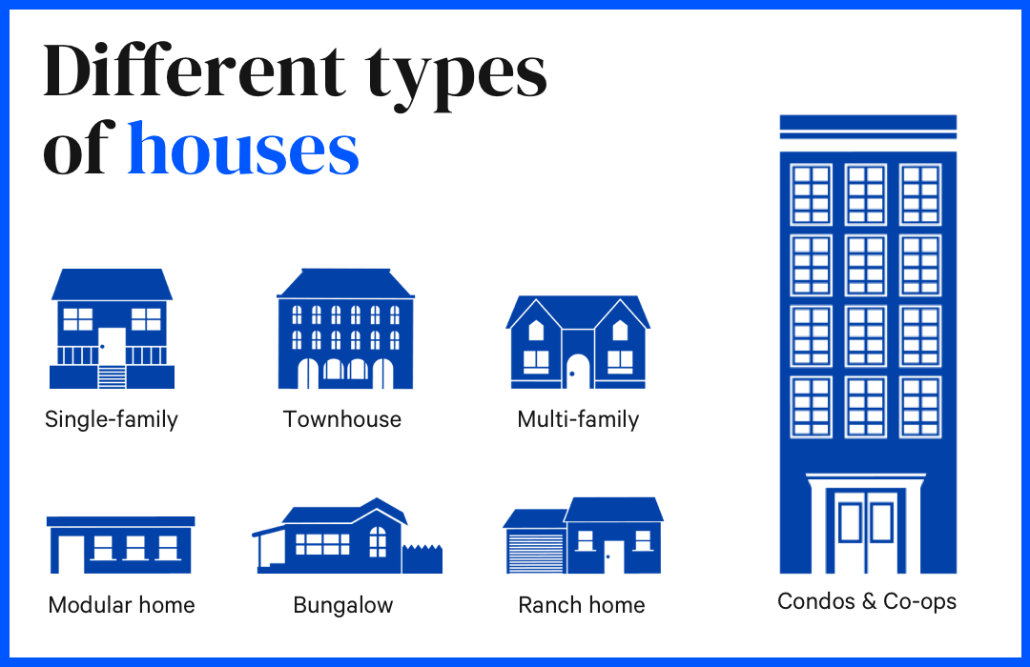
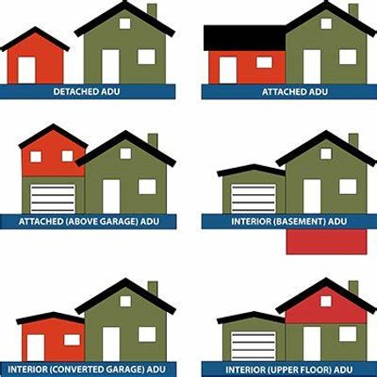
Housing
This element assesses a community’s housing needs, addresses housing affordability for workforce and low-income households along with types of housing.
It outlines strategies, policies, and implementation measures to meet these needs and guide future growth and development.

Slide 22
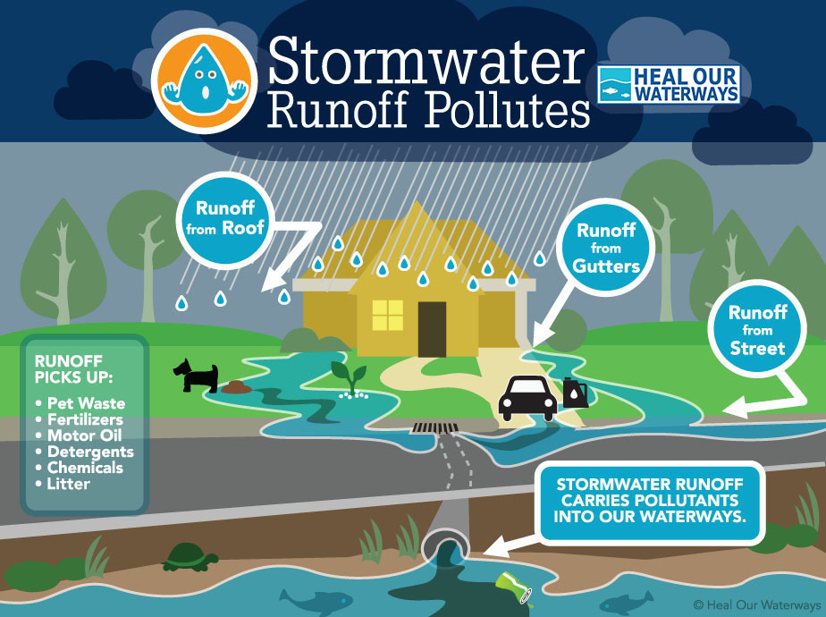
Water Resources
Water resources refers to the assessment and management of water supplies -both surface and groundwater - to meet the needs of a community’s existing and future population.
It also considers suitable receiving waters for wastewater and stormwater management.
This plan also outlines strategies for protecting and improving water quality for sustainable growth and environmental health.

Slide 23

The Comprehensive Plan is not a stand-alone document. It is supported (and in turn supports) other related documents including but not limited to:
Chesapeake Bay Critical Area Plan
Comprehensive Water & Sewer Plan
LPPRP
Floodplain Ordinance
Zoning Code
Subdivision Regulations
Septic Tier Maps (SB 236)
Road Ordinance
Forest Conservation Ordinance
Building Code
Livability Code
Stormwater Management Ordinance

Slide 24

UPDATED CITIZEN SURVEY
A citizen survey was done in 2020, however that data no longer reflects current conditions following COVID-19, new legislation and the ongoing housing crisis.
An updated survey is being distributed to gather more relevant feedback on current concerns and gain additional insights.
The 2025 Citizen Survey is available online at www.carolinemd.org/654/Caroline-County-Comprehensive-Plan
Please let your family, friends, and neighbors know so they can participate as well.

Slide 25
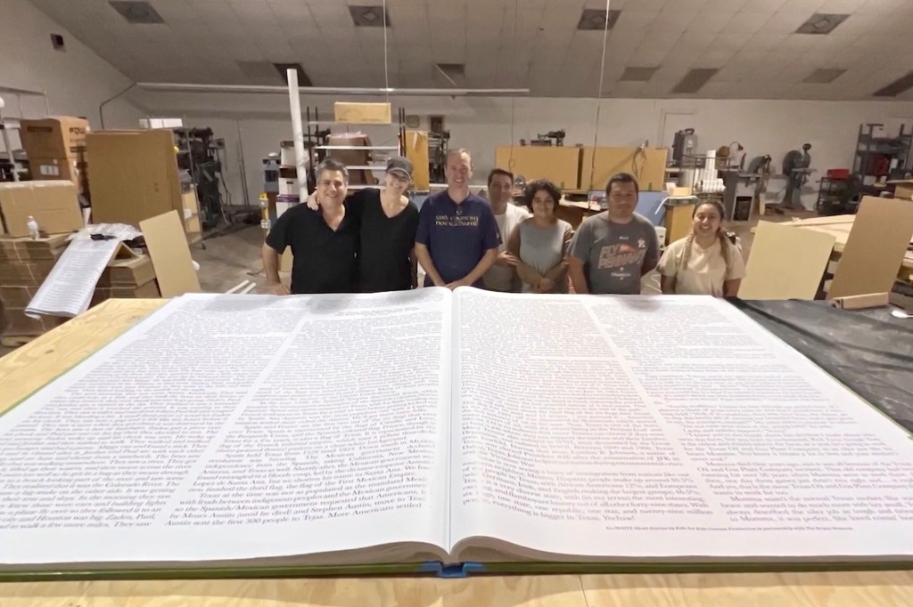
Review Process
The draft plan will be made available to the public online along with a hard copy available for review at the library and courthouse. It will be distributed to county departments, municipalities, adjacent jurisdictions, state agencies and MDP.
MDP’s role is advisory – it does not approve or deny the comprehensive plan.

Slide 26


PROCESS
It is important to follow the proper review and public procedures for these reasons:
Strengthens the legal defensibility of the plan
Builds community trust and transparency
Improves the quality of policy decisions
Ensures coordination across agencies and jurisdictions

Slide 27
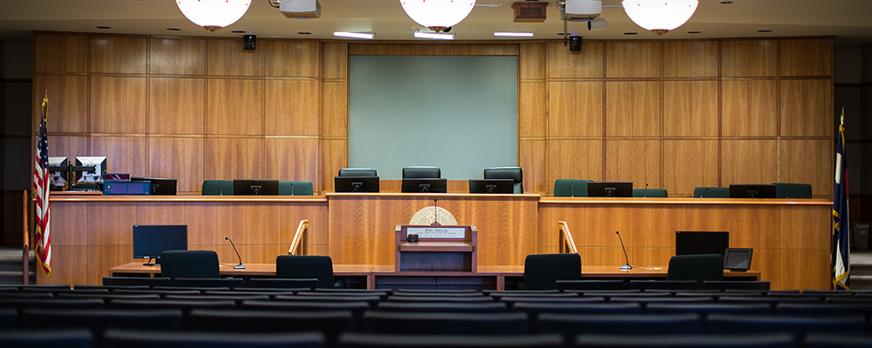
FINAL APPROVALS and ADOPTION
The Planning Commission must hold a public hearing to review the draft plan and make a recommendation to the County Commissioners.
The County Commissioners must hold a public hearing and formally adopt the plan by resolution or ordinance.

Slide 28

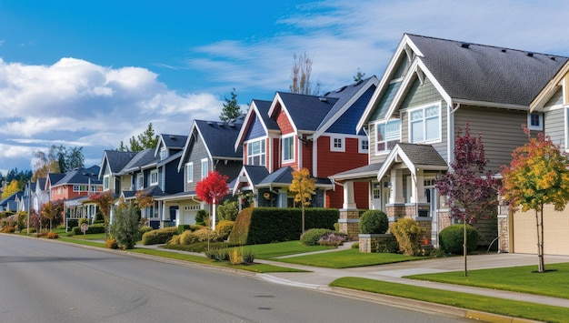

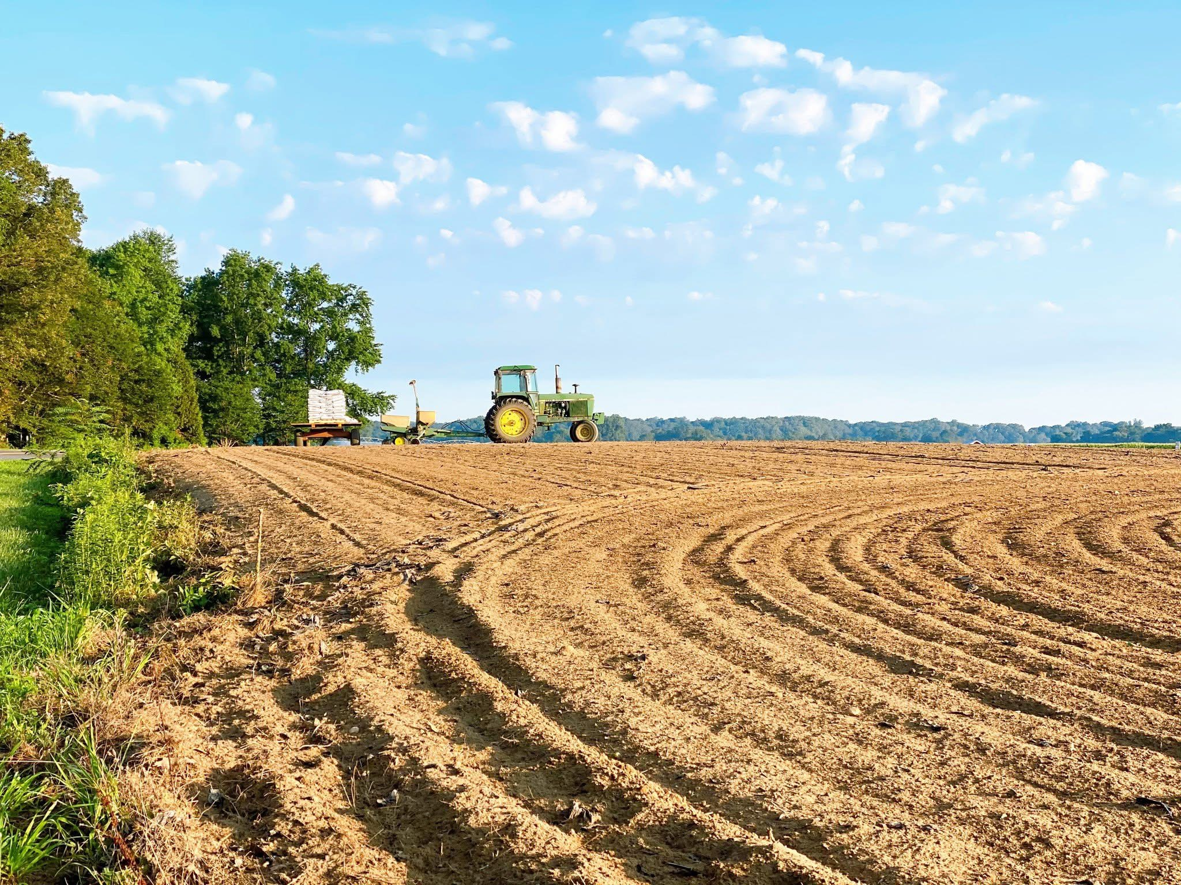

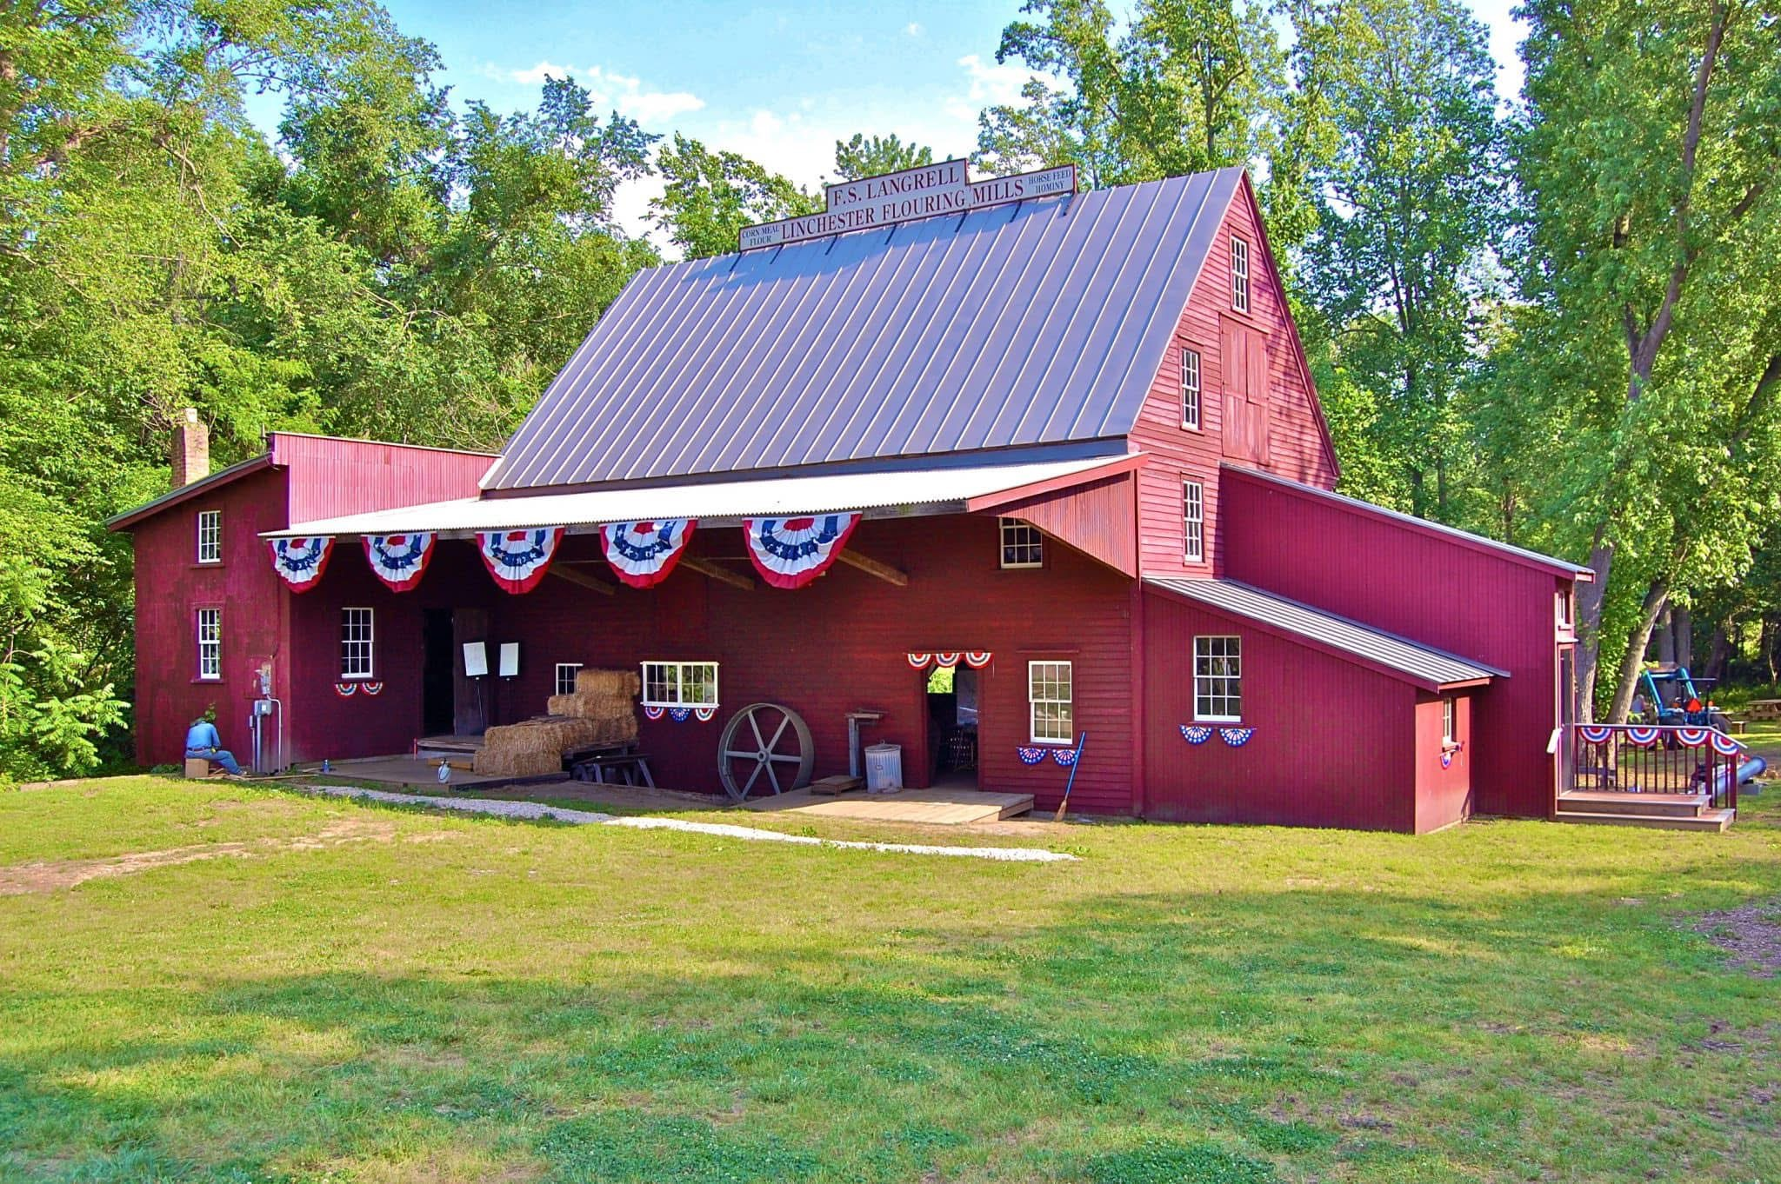

Your County, your plan, our future

Slide 29

How can I participate or get additional information on the Comprehensive Plan update?
Email questions or concerns. Request to be part of the updated survey at compplanupdate@carolinemd.org
Visit the Caroline County government website at www.carolinemd.org/654/Caroline-County-Comprehensive-Plan
Facebook = Caroline County Government
Updates on the Planning Commission meetings, Public Outreach Schedule and more will be listed and updated regularly.

